Slide 1
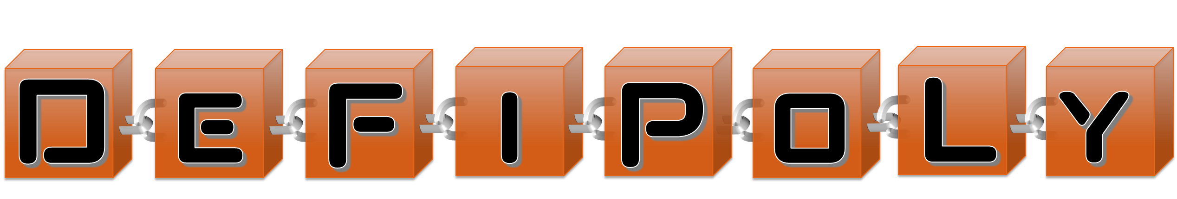
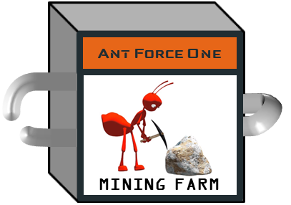
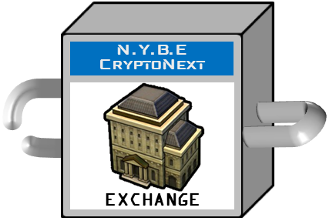
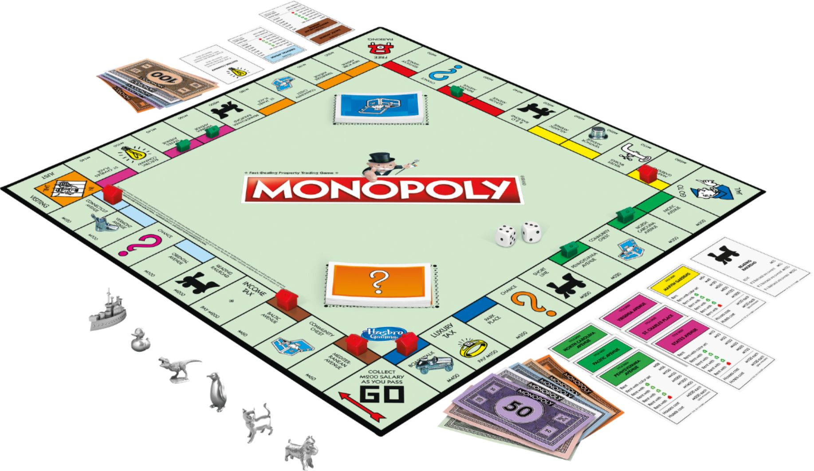
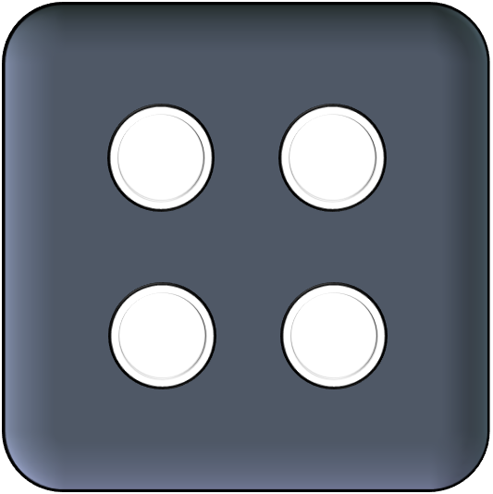
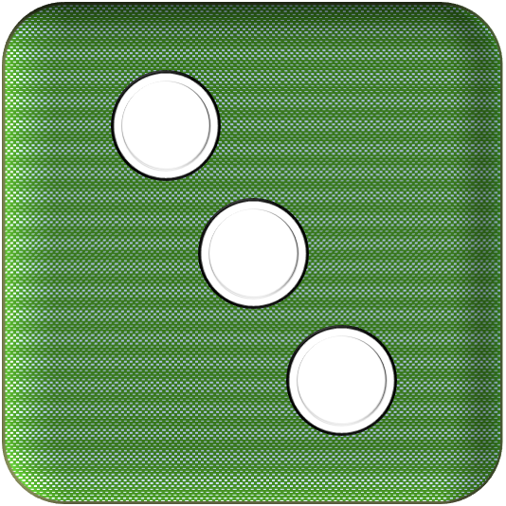
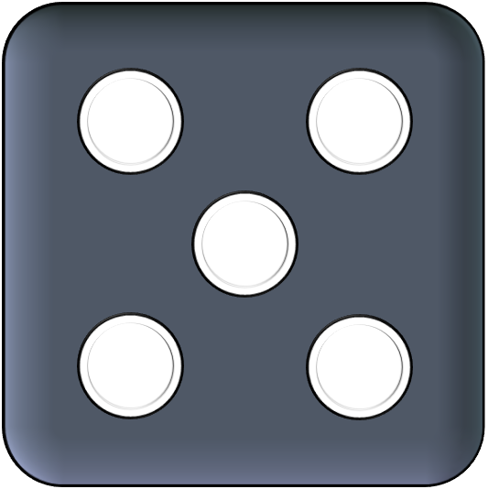
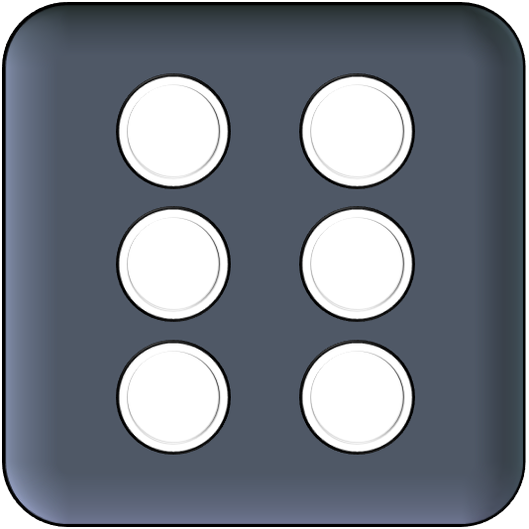
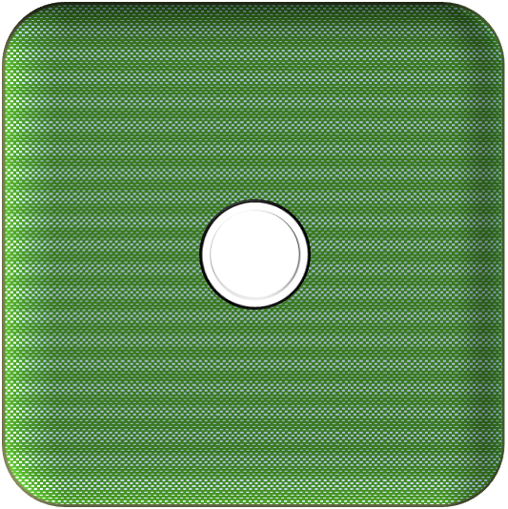
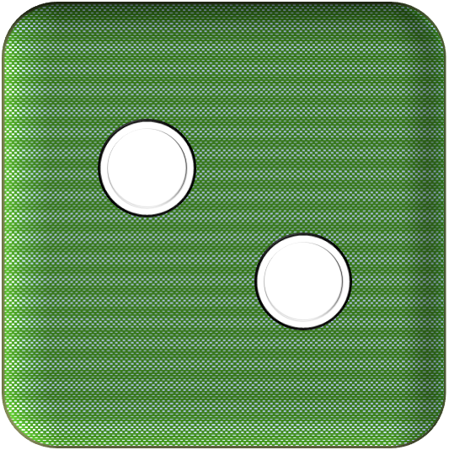

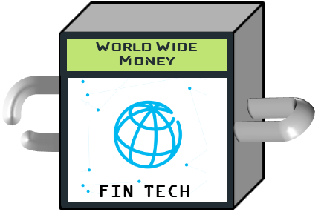


Slide 2
Challenge | Solution
Full decentralisation requires random number | CHAINLINK (VRF)
Seamless connection for users that doesn’t have an ETH account yet | PORTIS
Fast and cheap transactions | Layer 2 (MATIC)
No fees transactions Users doesn’t have native token (ETH on L1, MATIC on L2) | Gas Station Network
Fund the Gas Relay | Pool Together (on layer 1 !) Prize strategy = earned interest → Gas Relay Fund Gas Relay checks the TX signer has contributed to the pool (ticket token)
Pool Together fund on Layer 1, Gas Relay on Layer 2 | ?? Transfer ticket token from L1 to L2 ?? Oracle (CHAINLINK) to request L1 info from L2
Users have to connect both on L1 (to contribute to the pool) and L2 (to play game) | PORTIS

Slide 3






Layer 1
PrizeStrategy
Front-end
Layer 2
GameFactory contract
GameMaster contract
Token contract
Oracle
Gas Relay L2
Asset contract
….

Slide 4
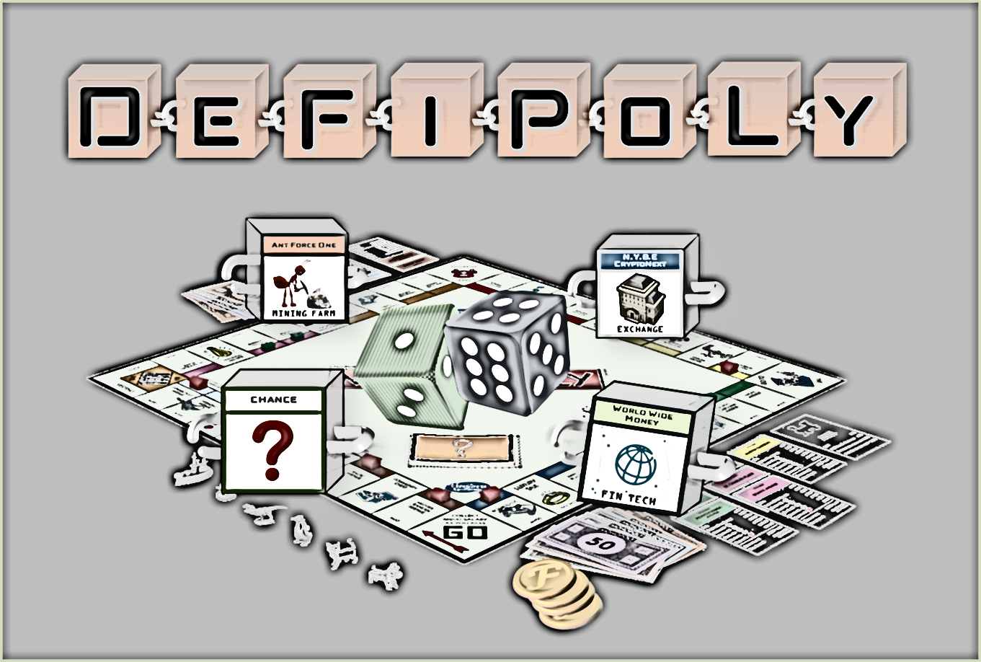
Demo

Slide 5
Achievements | Remains to be done
GameFactory contract: create contracts for a new game session | Complete game mechanisms in smart contracts
Initial front-end project, connection on L1 and L2 with PORTIS | Add VRF feature in CHAINLINK
CHAINLINK node deployed on MATIC | Integrate POOL-Together with customised Prize Strategy
 | Integrate Gas Relay on Layer 2
 | Complete Front-end

Slide 6

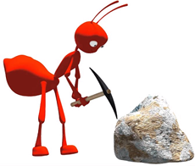
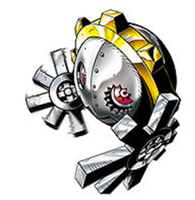








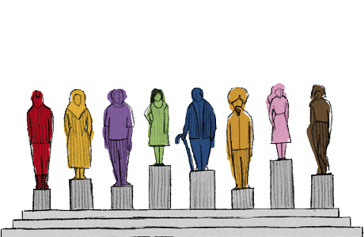

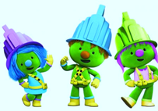
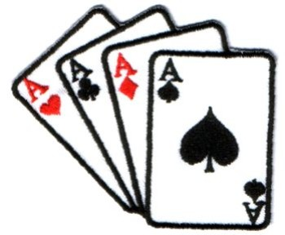






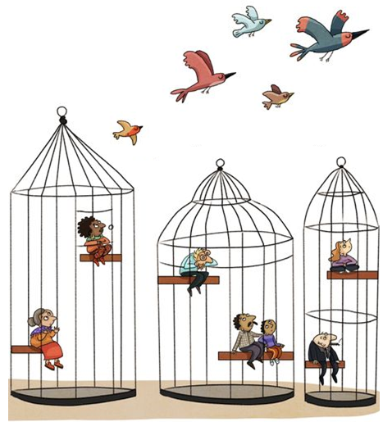

GENESIS
N.Y.B.E CryptoNext
Ant Force One
Remainers
From The Hashes
DecentraLife
Coinbridge
College
EXCHANGE
MINING FARM
GAME
BIO TECH
EDUCATION
COVID-19
The Grand
TezAAr
Pudding King
The Health Chain
World Wide
Money
Wealth Share
MARKETPLACE
BAKERY
BIO TECH
FIN TECH
SOCIAL
CHANCE
CHANCE
The 12
DOOZERS ARMY
Planet
of the Aces
Citizen Chain
Crypto On Chip
MINING FARM
GAME
LAW TECH
HW WALLET
COMMUNITY
CHEST
COMMUNITY
CHEST
Boiler Room
Privacy Connect
Smart Court
QUARANTINE
JUST
VISITING
BAKERY
SOCIAL
LAW TECH
This Photo by Unknown Author is licensed under CC BY
This Photo by Unknown Author is licensed under CC BY
This Photo by Unknown Author is licensed under CC BY

Slide 9
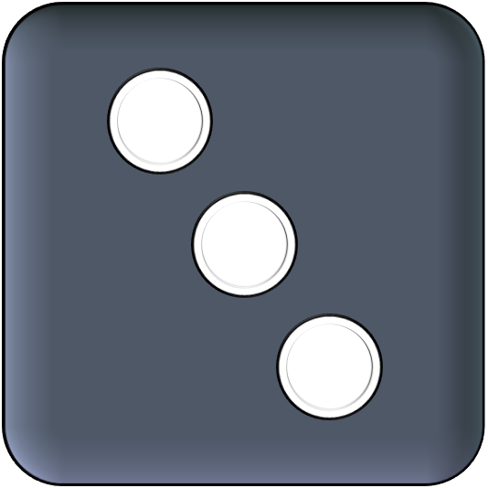
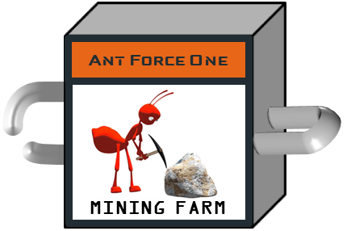

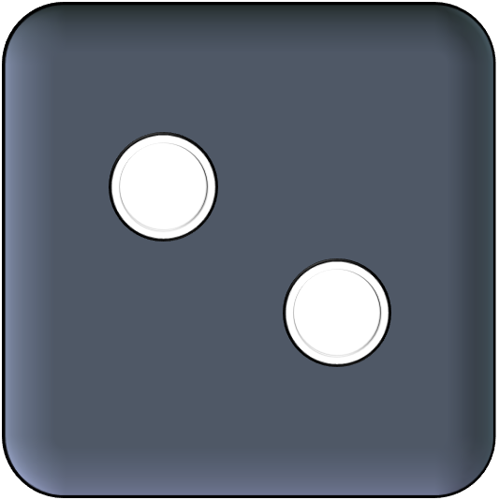
Ant Force One
MINING FARM

Slide 10

LawTech
BioTech
FinTech
EdTech
Gaming
Crypto
StarTech
CyberSec
GreenTech
Social Media

Slide 11



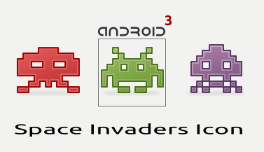


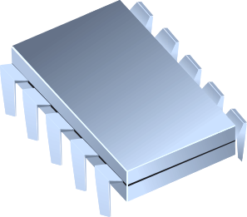



This Photo by Unknown Author is licensed under CC BY-SA-NC
This Photo by Unknown Author is licensed under CC BY-NC-ND
This Photo by Unknown Author is licensed under CC BY-NC-ND
This Photo by Unknown Author is licensed under CC BY-NC
This Photo by Unknown Author is licensed under CC BY-SA
This Photo by Unknown Author is licensed under CC BY

Slide 12





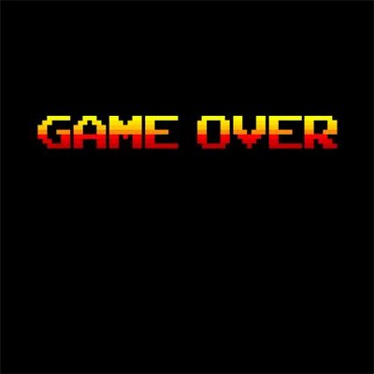



W
i
n
n
e
r
h
This Photo by Unknown Author is licensed under CC BY-NC-ND
k
T
a
n
s
This Photo by Unknown Author is licensed under CC BY-ND

Slide 13
Found A Crypto Startup
Invoke Your Community Chest
Mine And Get Rewards
Stake And Get Rewards
Invest In Your Products
Run A Token Exchange
Launch An ICO
Took A Chance !
Run An NFT Marketplace
Buy/Sell Crypto-Assets

Slide 14

Venture
D
e
F
i
T
h
a
n
k
s
ℱ
ℱ
ℱ
ℱ
ℱ
100
ℱ
100
100
100
POWERED BY:

Slide 15
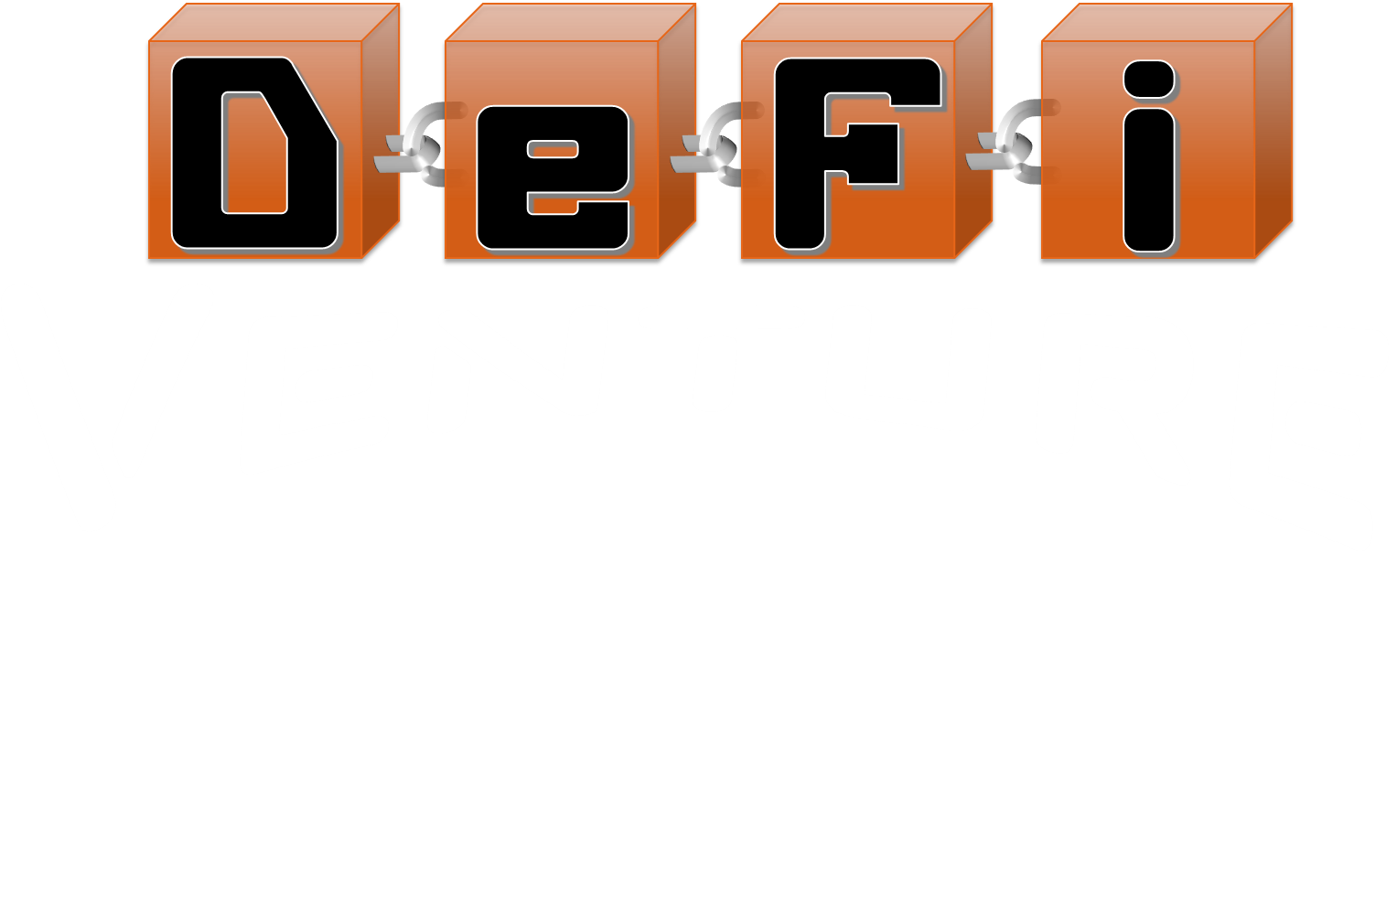



Slide 16



D
e
F
i
Venture
ℱ
ℱ
POWERED BY
ℱ
100
L
100
100
100
L
FEATURING
L

Slide 17
D
e
F
i
Venture
ℱ
ℱ
POWERED BY
ℱ
100
L
100
100
100
L
FEATURING
L

Slide 18

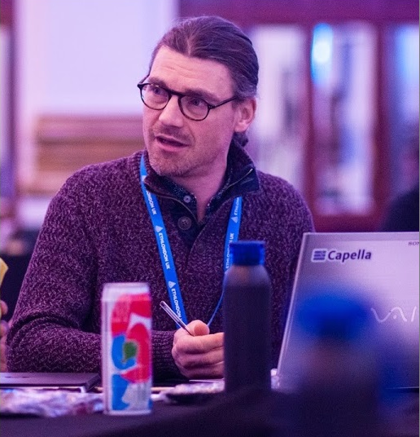


Who I am
Ludovic LEVALLEUX
ETHOnline
BUIDLER
Notes:
Hi Guys!
My name is Ludovic and I’m going to present DeFi-Venture, the game I’ve built for ETHONLINE Hackathon 2020

Slide 19
Teaser Video

Slide 20
Try It
Live Demo https://levalleux-ludo.github.io/DAPP/DeFiVenture/demo.html deployed on Matic Mumbai Testnet @GameFactory 0xf417DAF7106BEc2ee19403259340c53336e4CB81
Notes:
I really hope you have enjoyed this short teaser.
The game is deployed on Matic testnet and you can play live at the URL below.

Slide 21


How it is made
Fully decentralized game
GameFactory
creates
GameMaster
Front-End
GameToken (is ERC20)
GameAssets (is ERC721)
Marketplace
Oracle
VRFCoord
Notes:
Let me describe quickly its architecture
DeFi-Venture is a fully-decentralized game, meaning that all the game’s mechanisms are performed on the Matic blockchain by a set of smart-contracts.
PORTIS is used as a gateway to connect to the Matic Blockchain.
This is a very good solution to embark users that doesn’t have a crypto-wallet yet.
A GameFactory contract is responsible to create the other contracts required for a game session.
There is an ERC20 smart contract to represent the in-game currency, an NFT contract to manage ownership of startups, a game master contract to implement and check the game rules, and a marketplace contract to manage exchanges.
In addition, a Chainlink VRF Coordinator is also used to generate random numbers.

Slide 22
How it works
Typical one user’s play round
FrontEnd
GameMaster
GameToken (is ERC20)
GameAssets (is ERC721)
VRFCoord
Roll the Dices
RollDices()
getRandom()
dice1, dice2,
newPosition, availableOptions
random
Select Option
Play(option: BUY ASSET)
burn(amount)
Go next player
mint(assetId)
Notes:
Now, let’s have a quick look at a typical play round.
The user rolls the dices by calling the gamemaster contract, that returns the random values for dices, the new position reached by the player on the board, and the available options he can choose.
Then, the player chooses one of them and call the contract again to perform the required actions.
For this example, the player is acquiring an asset, paying for it a certain amount of tokens.

Slide 23



Future works
Complete in-game DeFi + Marketplace mechanisms
Chainlink VRF deployment on
Gasless transaction fees ( on ) Concept Pool To Play to fund Gas Relay ( )
3D version ( )
Have lots of fun playing with family and friends ☺ !!
Notes:
The development of this game doesn’t stop now.
First, I need to complete the most advanced mechanisms of the game.
I also need Chainlink VRF to be deployed on Matic (that is not done yet)
Then, I would be able to deploy on Mainnet.
Moreover, the users should be able to play without paying fees, thanks to a GasRelay that would be funded by a no-loss prize pool, but I didn’t have the time to integrate it yet.
Finally, I think about a 3D version of the playground deployed in Decentraland.
And more than that, I would like to play with family and friends.

Slide 24








L
L
100
L
ℱ
100
L
ℱ
L
ℱ
100
L
100
100
This Photo by Unknown Author is licensed under CC BY
100
L
L
L
This Photo by Unknown Author is licensed under CC BY-SA
This Photo by Unknown Author is licensed under CC BY-NC-ND
This Photo by Unknown Author is licensed under CC BY-NC-ND
This Photo by Unknown Author is licensed under CC BY-SA
This Photo by Unknown Author is licensed under CC BY-SA
Notes:
I hope you’ve enjoyed this presentation and appreciate my work.
Thanks for your attention.

